Slide 1
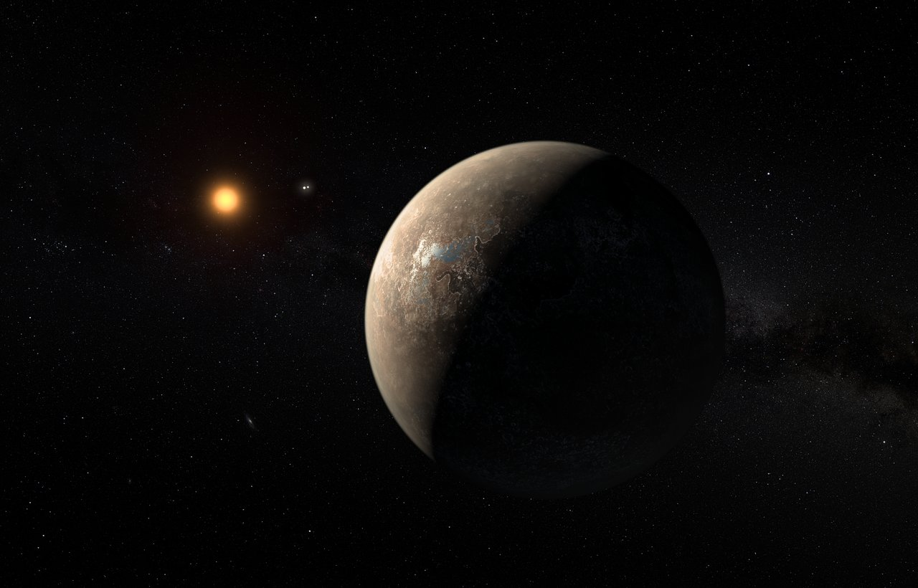

Confirmation Review
Gauss-Hermite Decomposition towards Quantifying Spectral Line-Profile Variability in Radial Velocity Detection of Exoplanets
Jinglin Zhao
Supervisor: Chris Tinney
Co-supervisor: Robert Wittenmyer

Slide 2
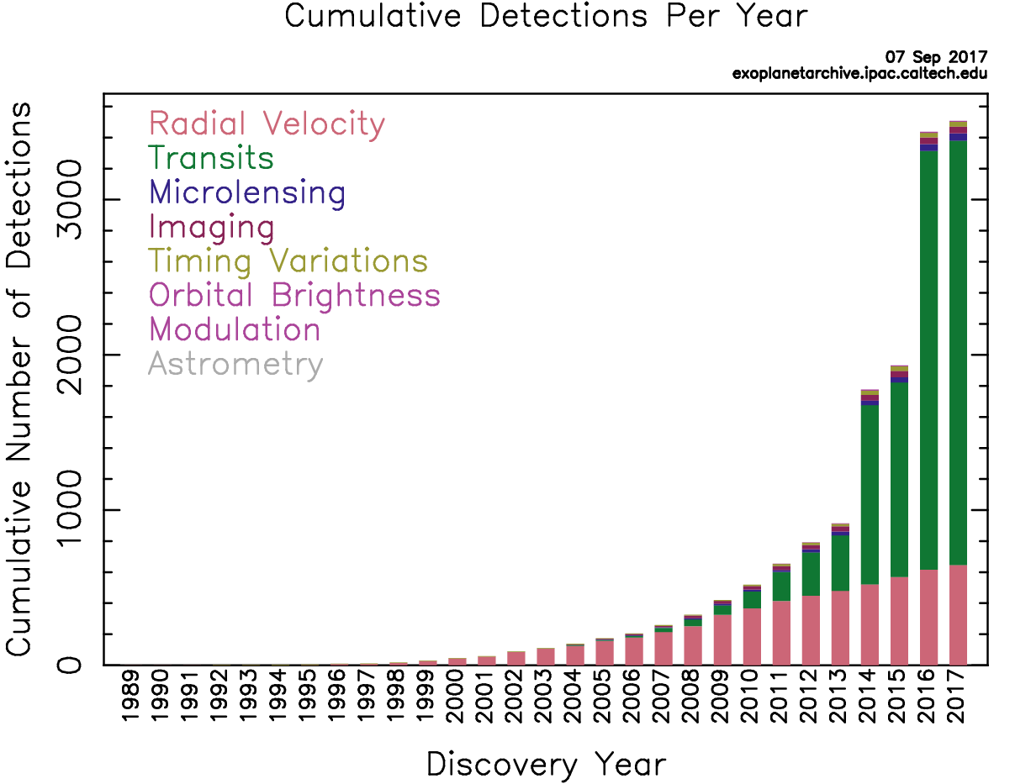
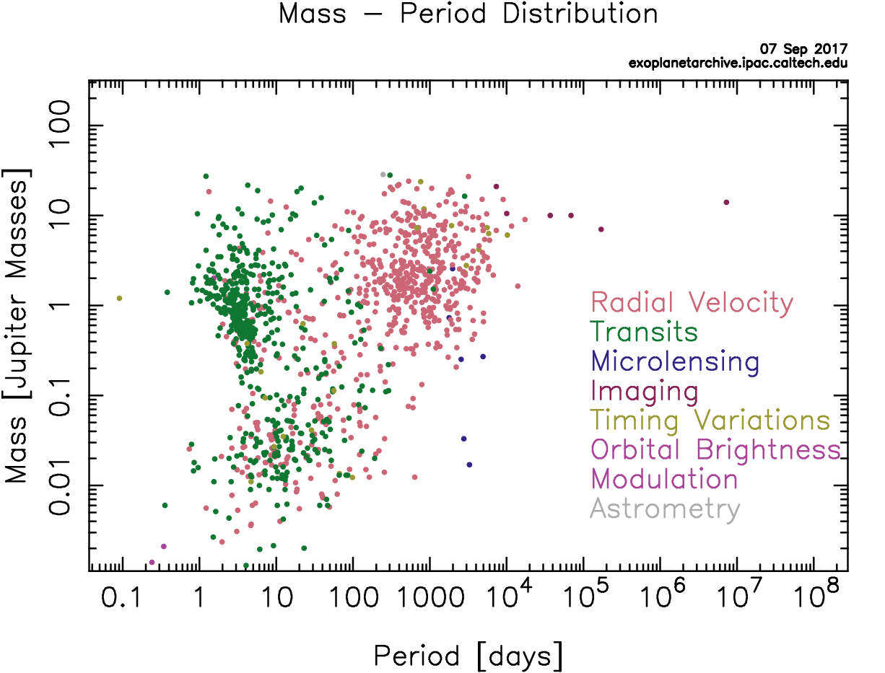
Detection of Exoplanets
Future
Search for low-mass planets
Precise characterization of exoplanets
To date
3509 exoplanets (3576)
584 multiple planet systems (602)
NASA EXOPLANET ARCHIVE -- https://exoplanetarchive.ipac.caltech.edu/exoplanetplots/

Slide 3
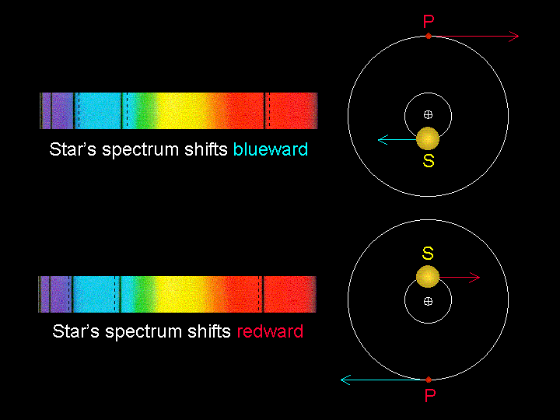
Radial Velocity Detection
http://faculty.uca.edu/njaustin/PHYS1401/Laboratory/exoplanet.html

Slide 4
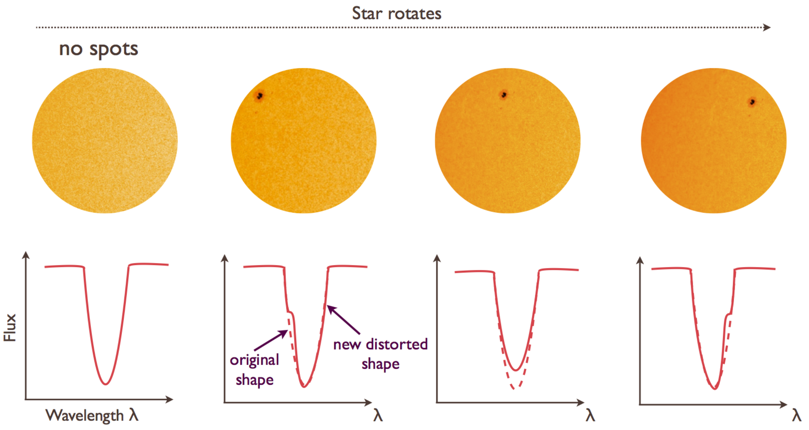
Stellar Jitter
Haywood 2015
Sunspots and starspots
Faculae
Plages
Flares
Stellar granulation
Stellar oscillations
Dark spot
Flux imbalance on stellar disc
Spectral line asymmetry
Radial velocity variation (i.e. jitter)
RV_{obs}= RV_{p} + jitter
Comparable amplitude and timescale

Slide 5
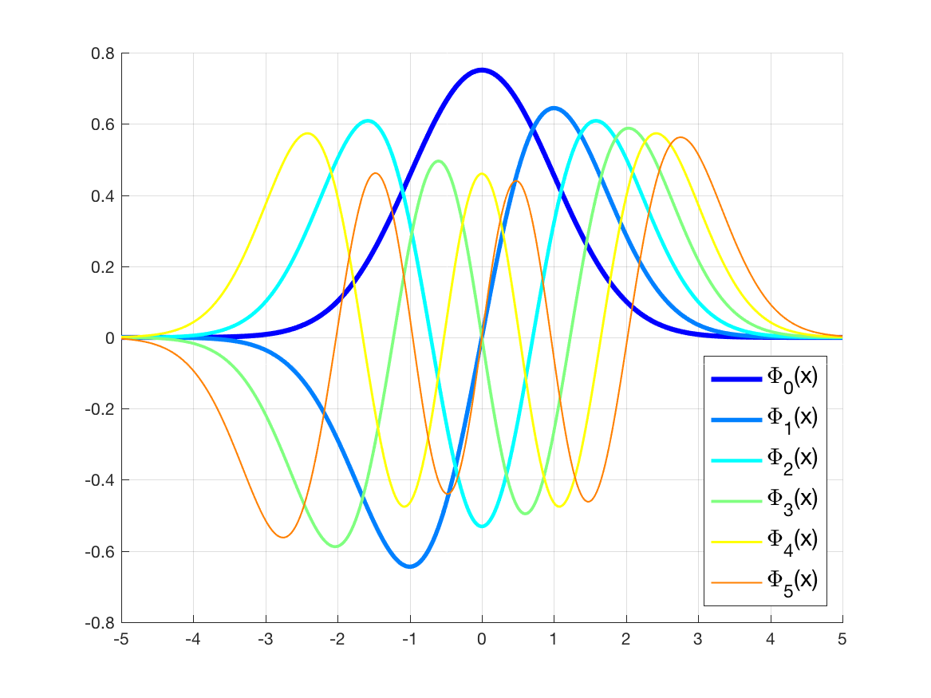
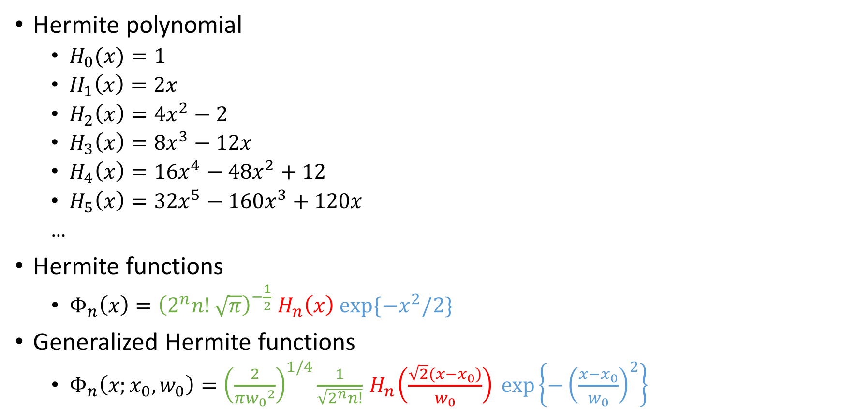
Orthonormal Basis: Hermite functions
Hermite polynomial
$H_{0}(x)=1$
$H_{1}\left(x\right)=2x$
$H_{2}\left(x\right)=4x^{2}−2$
$H_{3}\left(x\right)=8x^{3}−12x$
$H_{4}\left(x\right)=16x^{4}−48x^{2}+12$
$H_{5}\left(x\right)=32x^{5}−160x^{3}+120x$
…
Hermite functions
$Φ_{n}\left(x\right)={\left(2^{n}n!\sqrt{π}\right)}^{−\frac{1}{2}}{ H}_{n}\left(x\right) exp⁡\{−x^{2}/2\}$
Generalized Hermite functions
$Φ_{n}\left(x;x_{0},w_{0}\right)={\left(\frac{2}{π{w_{0}}^{2}}\right)}^{1/4}\frac{1}{\sqrt{2^{n}n!}}{ H}_{n}\left(\frac{\sqrt{2}\left(x−x_{0}\right)}{w_{0}}\right) exp\left\{−{\left(\frac{x−x_{0}}{w_{0}}\right)}^{2}\right\}$

Slide 6
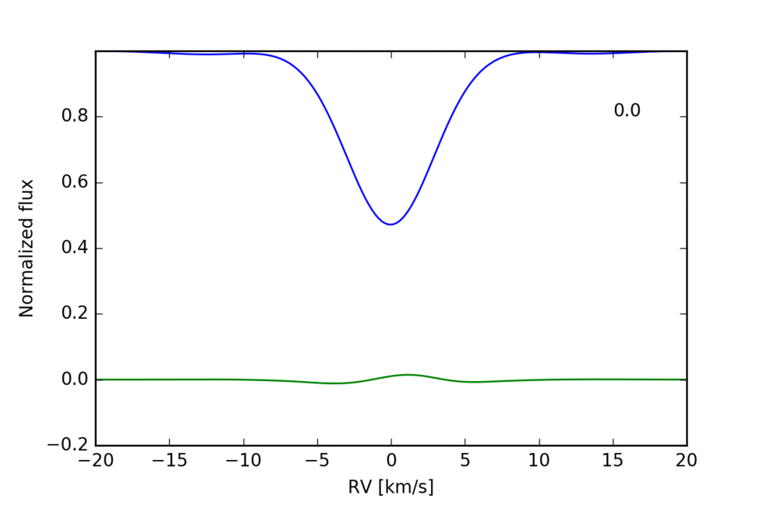
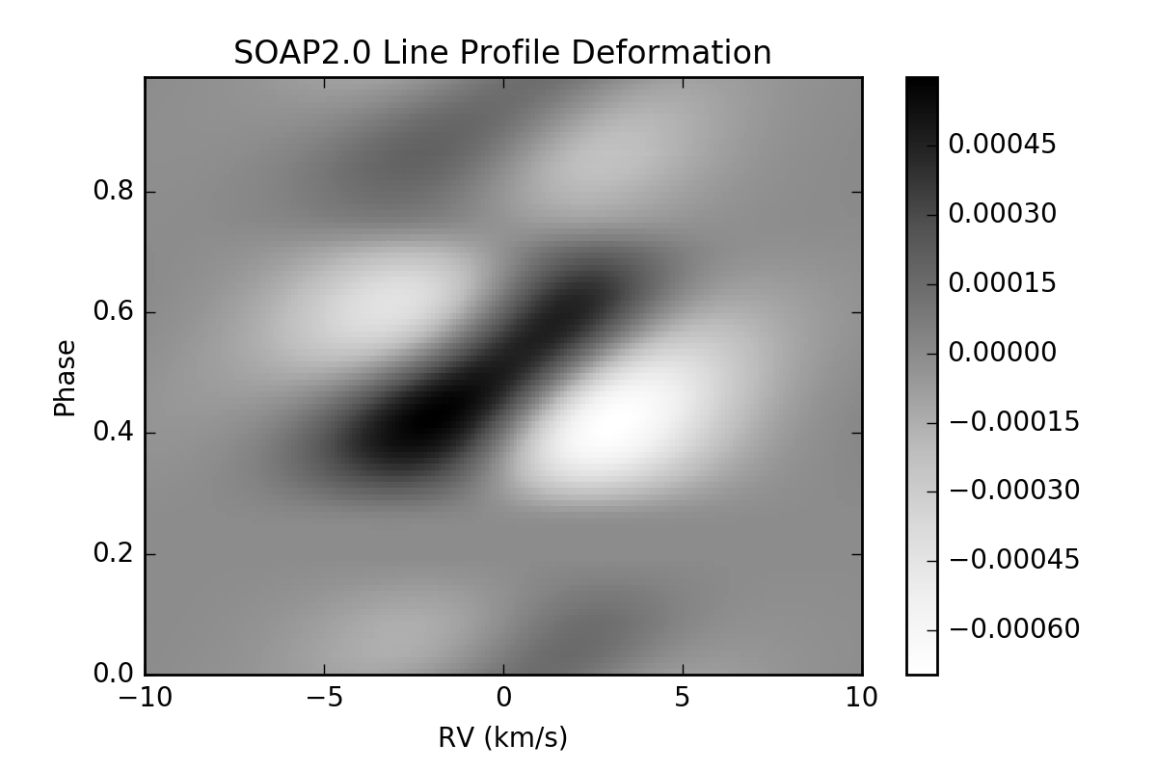
Simulation – Line-profile Deformation

Slide 7
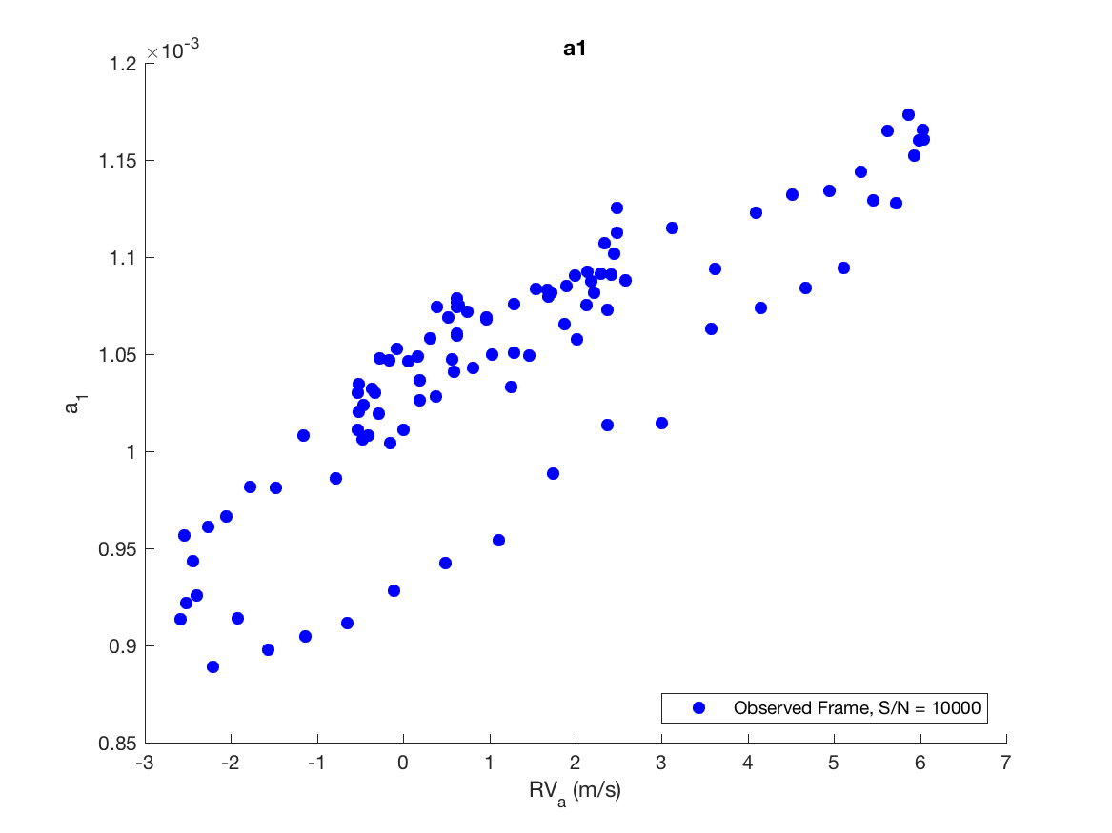
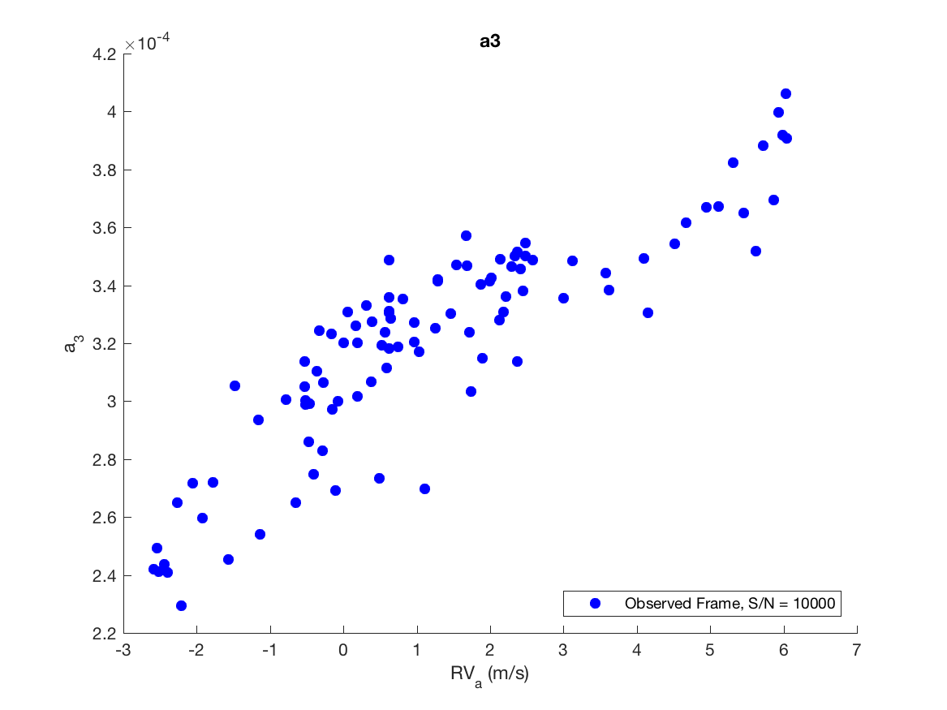
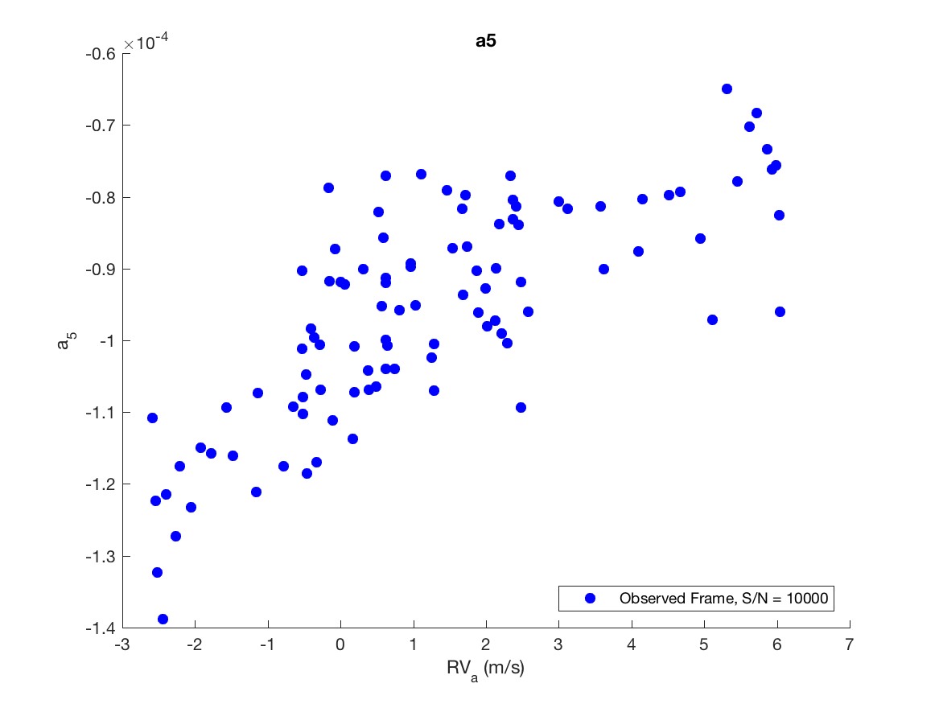
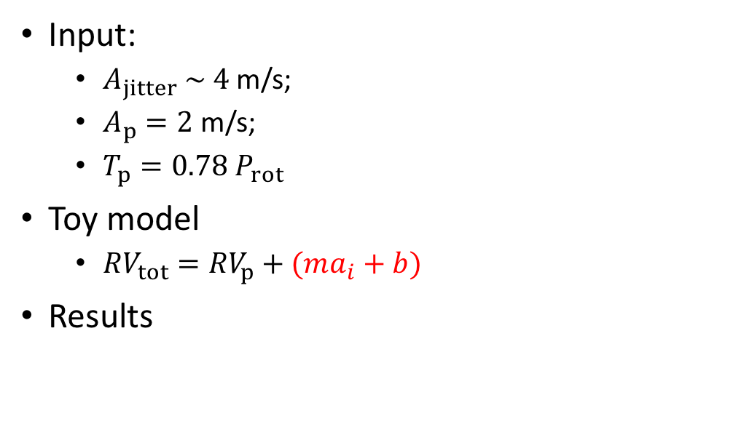
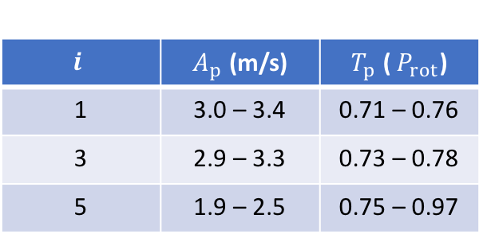
Test 1: End-to-end Simulations
Input:
$A_{jitter} \sim 4$ m/s;
$A_{p}=2$ m/s;
$T_{p}=0.78{ P}_{rot}$
Toy model
${RV}_{tot}={RV}_{p}+(ma_{i}+b)$
Results
$$i$$ | $A_{p}$ (m/s) | $T_{p}$ (${ P}_{rot}$)
1 | 3.0 – 3.4 | 0.71 – 0.76
3 | 2.9 – 3.3 | 0.73 – 0.78
5 | 1.9 – 2.5 | 0.75 – 0.97

Slide 8
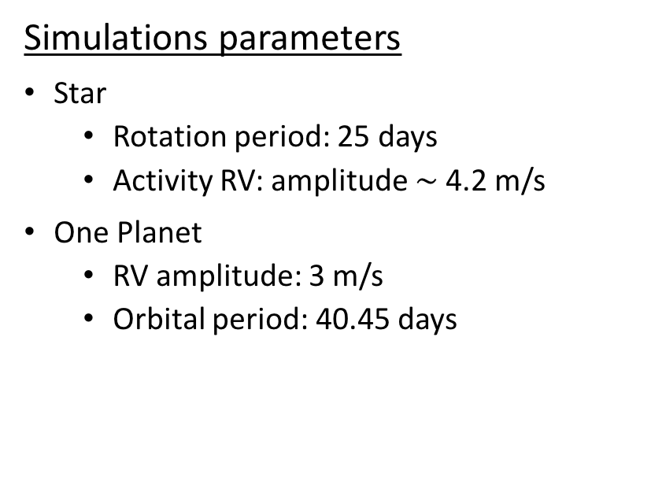
Test 2: Multispectral Periodogram Analysis
Simulations parameters
Star
Rotation period: 25 days
Activity RV: amplitude $\sim$ 4.2 m/s
One Planet
RV amplitude: 3 m/s
Orbital period: 40.45 days
Rest frame Planet and jitter | Even orders Jitter
Observed frame Only jitter | Odd orders Planet and jitter

Slide 9
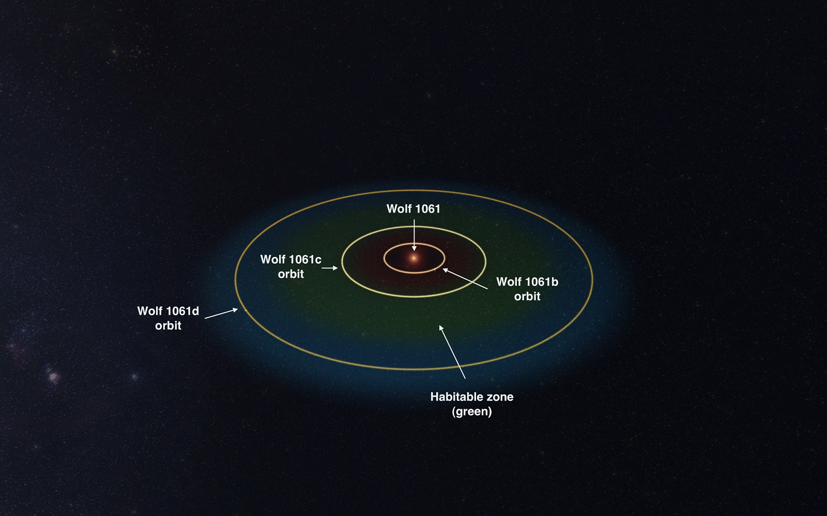
Test 3: Wolf 1061
if odd order && observed frame
planet and jitter
else
jitter
Companion | Min Mass | Orbital Period (days)
b | 1.36 M_{Earth} | 4.8876 ± 0.0014
c | 4.25 M_{Earth} | 17.867 ± 0.011
d | 5.21 M_{Earth} | 67.27 ± 0.12
https://www.science.unsw.edu.au/news/discovery-nearby-star-hosts-closest-alien-planet-“habitable-zone”

